Slide 1
4.28.2020
Machine Learning In TensorFlow
Kevin Ford
kevinf@magenic.com
617 359-5192

Slide 2
https://github.com/Magenic/MMLTensorflow
https://www.amazon.com/Deep-Learning-TensorFlow-Keras-Regression-ebook/dp/B082MBMFVF/ref=sr_1_4?dchild=1&keywords=tensorflow+2.0&qid=1587071084&sr=8-4

Slide 3
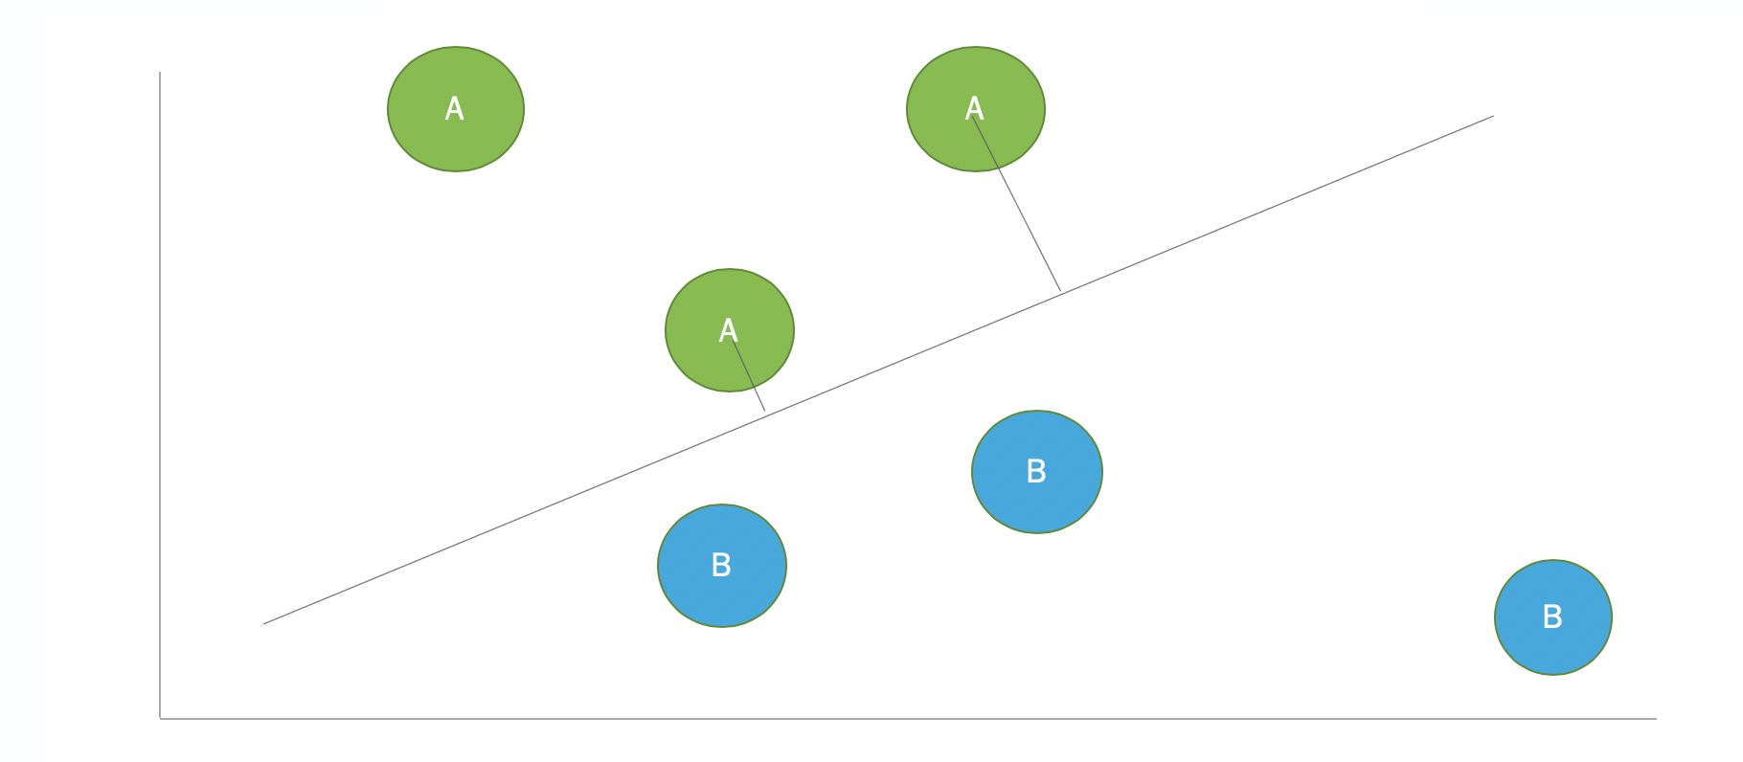
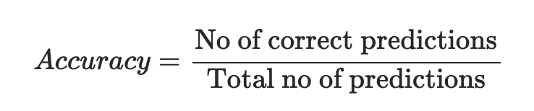
Loss vs. Accuracy
Loss

Slide 4
Ways to improve our model
Hidden layers
Dropout
Different Optimizers
Change the number of epochs
Controlling the learning rate
Changing the number of neurons
Changing the batch size
Regularization

Slide 5
Hidden Layers – Creating a Multi-layer Perception
Input layer
Hidden layer
Output layer
Additional neurons help learn more complex patterns
Layer 1
Layer 2
Layer n
Does not need the same number of neurons as the results
Use a different activation than Softmax, try RELU

Slide 6
Demo 1 : Multi-layer Perception with Hidden Layer

Slide 7
Dropout Layers
Randomly drops values from preceding layer
Forces learning of redundant patterns for better generalization
Only happens when training the model, not in execution
Input Layer
Dropout Layer
Hidden Layer
Dropout Layer
Output Layer
model.add(keras.layers.Dropout({amount to randomly drop}))

Slide 8
Demo 2 : Multi-layer Perception with Dropout Layer

Slide 9

Different Optimizers
SDG - Stochastic gradient descent
RMSProp – Root Mean Square Prop
Adam - derived from adaptive moment estimation
SGD - Gradient Descent

Slide 10
Demo 3 : Different Optimizers

Slide 11
Change the Number of Epochs
Too many epochs and wasting unnecessary training time
Too many can be seen when each epoch does not make the model materially more accurate
Too few and the model will not be accurate enough
Too few can be seen when the test results are more accurate than the last training epoch
Best to experiment on the low side and fail fast

Slide 12
Demo 4 : Changing the Number of Epochs

Slide 13
Controlling the learning rate
opt = keras.optimizers.Adam(learning_rate=0.0001)
model.compile(optimizer=opt, loss='categorical_crossentropy', metrics=['accuracy'])

Slide 14
Demo 5 : Controlling the Learning Rate

Slide 15
Changing the Number of Neurons
More neurons per layer can help increase accuracy
At some point too many neurons can decrease accuracy
More neurons, more computation power required, including in the final model!

Slide 16
Demo 6 : Changing the Number of Neurons

Slide 17
Changing the Batch Size
SDG optimizer only considers batch size examples
Cost and accuracy can be adjusted by adjusting the batch size
Can substantially change the training time for each epoch

Slide 18
Demo 7: Changing the Batch Size

Slide 19
Regularization
Problems with overfitting and excessively complex models
May take longer to execute model
May perform poorly with real world data
Overfitting happens when the loss on validation data starts to increase
Given two models that achieve the same result we should select the simplest model

Slide 20
Calculating Model Complexity
L1 – LASSO – Sum of the absolute values of the weights
L2 – Ridge – Sum of the squares of the weights
Elastic Regularization – Combination of L1 and L1 complexity measurements

Slide 21
Demo 8: Measuring Complexity

Slide 22
Homework reading
https://kharshit.github.io/blog/2018/12/07/loss-vs-accuracy
https://towardsdatascience.com/understanding-rmsprop-faster-neural-network-learning-62e116fcf29a
https://towardsdatascience.com/a-look-at-gradient-descent-and-rmsprop-optimizers-f77d483ef08b
Book pages 21-39
Modify Wk02-Homework-Model02 experiment to optimize its accuracy and loss. Send me your final figures. Next week the winner can explain what they did.

Slide 23
Q & A
New week – Convolutional Neural Networks

